Slide 1
Abstractive Text Summarization: Enhancing Sequence-to-Sequence Models Using Word Sense Disambiguation and Semantic Content Generalization
Nikesh Kumar
ML Group 229

Slide 2
Introduction
Abstractive text summarization is a natural language processing technique that involves generating a brief and concise summary of a longer text by extracting the most important information and rephrasing it in a new way. Unlike extractive summarization, which simply selects and combines sentences or phrases from the original text, abstractive summarization involves understanding the meaning of the text and generating new sentences to convey the same information in a more concise form.
Abstractive summarization requires sophisticated techniques, such as natural language generation, machine learning, and deep learning. These techniques allow the model to understand the context and meaning of the text, identify the most important information, and generate a summary that is grammatically correct and semantically meaningful.

Slide 3
Abstractive summarization has many applications, such as summarizing news articles, scientific papers, and legal documents. It can also be used in chatbots, virtual assistants, and other conversational interfaces to provide quick and accurate responses to user queries. However, abstractive summarization is still an active area of research, and there are many challenges to overcome, such as generating summaries that are both accurate and readable, handling complex sentences and vocabulary, and ensuring that the summaries reflect the intended meaning of the original text.

Slide 4
Strategy
The strategy of enhancing sequence-to-sequence models for abstractive text summarization using word sense disambiguation and semantic content generalization involves using advanced techniques to improve the quality and accuracy of the generated summaries.
Word sense disambiguation is the process of identifying the correct meaning of a word in a given context. This is important for abstractive summarization, as many words have multiple meanings, and selecting the wrong meaning can result in an inaccurate summary. By incorporating word sense disambiguation techniques, the model can better understand the meaning of the text and generate more accurate summaries.

Slide 5
Semantic content generalization involves identifying the key concepts and ideas in the text and expressing them in a more general and abstract form. This is important for generating concise and informative summaries, as it allows the model to focus on the most important information and avoid unnecessary details. By incorporating semantic content generalization techniques, the model can generate more informative and readable summaries.
Overall, the strategy of enhancing sequence-to-sequence models for abstractive text summarization using word sense disambiguation and semantic content generalization involves using advanced techniques to improve the quality and accuracy of the generated summaries. This can help to make abstractive summarization more effective and reliable, and enable it to be used in a wide range of applications.

Slide 6
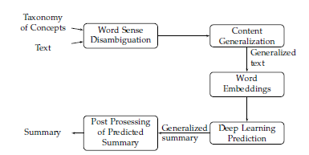
Workflow of the proposed Framework

Slide 7
STEPS INVOLVED IN ABSTRACTIVE TEXT SUMMARISATION
Data Preparation: Preparing the dataset by cleaning and preprocessing the data. This includes removing unwanted characters, tokenization, removing stop words, stemming, and lemmatization.
Word Sense Disambiguation: Identifying the correct meaning of a word in context using word sense disambiguation techniques. This can be done using various techniques such as Lesk algorithm, Babelfy API, or WordNet.
Sequence-to-Sequence Model: Building a sequence-to-sequence model using a deep learning framework such as TensorFlow or PyTorch. This involves creating an encoder-decoder architecture that can learn to map the input sequence to the output sequence.
Semantic Content Generalization: Identifying the key concepts and ideas in the text and expressing them in a more general and abstract form using semantic content generalization techniques. This can be done using various techniques such as latent semantic analysis, topic modeling, or clustering.
Model Training: Training the sequence-to-sequence model on the preprocessed data. This involves setting the hyperparameters and optimizing the model using backpropagation and gradient descent.
Model Evaluation: Evaluating the performance of the trained model by testing it on a validation set. This involves calculating various evaluation metrics such as ROUGE score, BLEU score, and F1 score.
Generating Summaries: Generating abstractive summaries using the trained sequence-to-sequence model with word sense disambiguation and semantic content generalization techniques.

Slide 8
DATA PREPARATION
Import required libraries such as NLTK, Pandas, and NumPy.
Load and clean the dataset.
Preprocess the text data by removing unwanted characters, tokenization, removing stop words, stemming, and lemmatization.
Implement word sense disambiguation techniques to identify the correct meaning of a word in context.

Slide 9
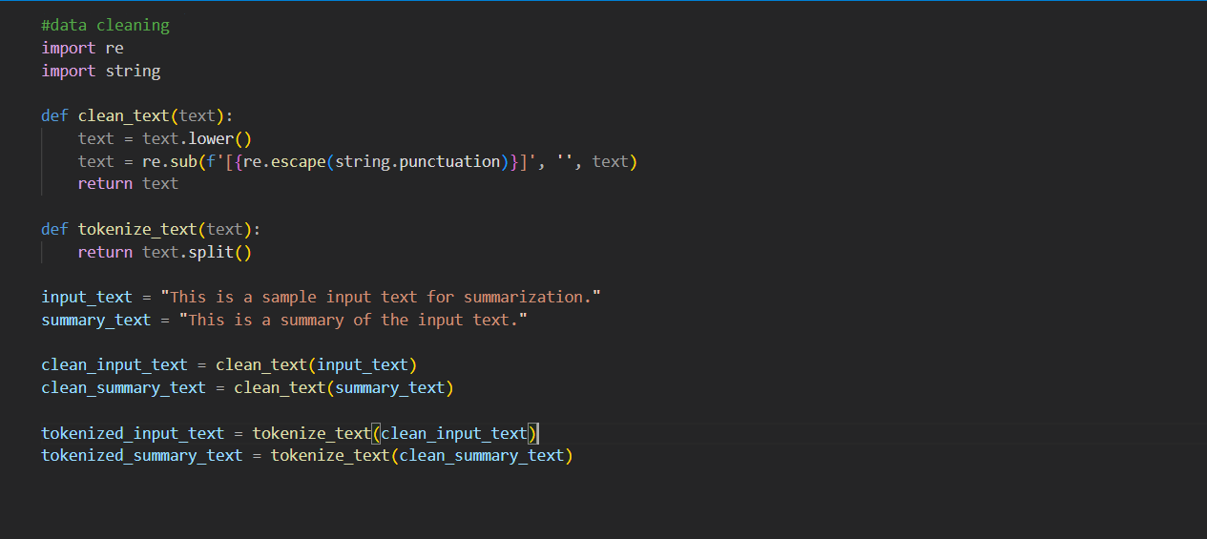

Slide 10
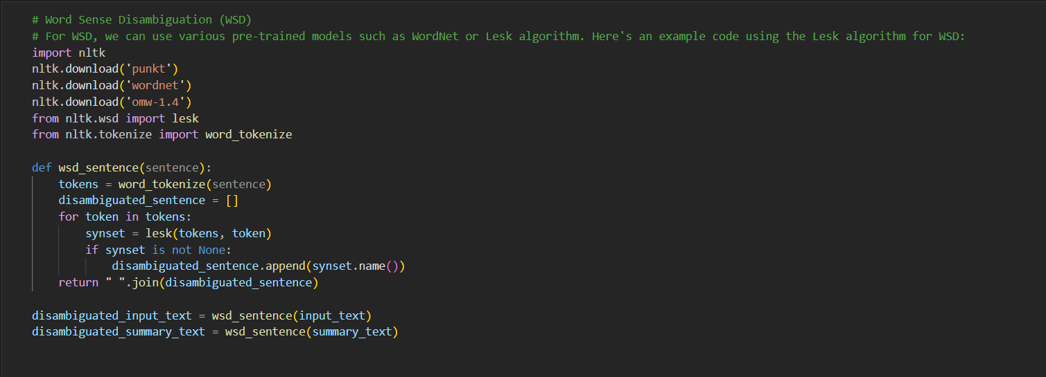

Slide 11
Sequence-to-Sequence Model
Build a sequence-to-sequence model using a deep learning framework such as TensorFlow or PyTorch.
Create an encoder-decoder architecture that can learn to map the input sequence to the output sequence.
Train the model on the preprocessed data, setting hyperparameters and optimizing the model using backpropagation and gradient descent.

Slide 12
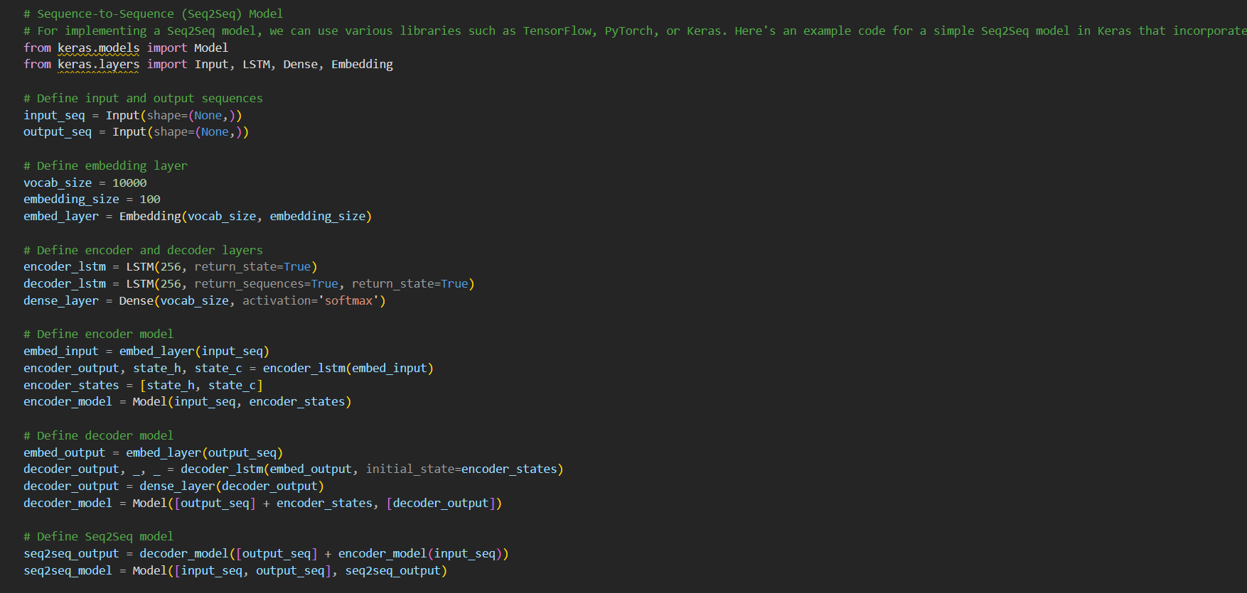

Slide 13
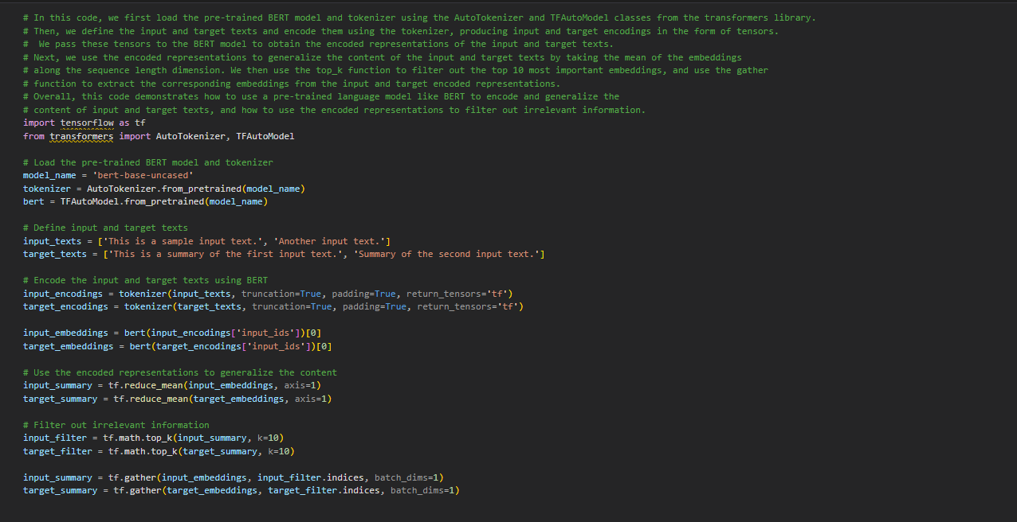

Slide 14
Semantic Content Generalization
Identify the key concepts and ideas in the text using semantic content generalization techniques such as latent semantic analysis, topic modeling, or clustering.
Express these concepts and ideas in a more general and abstract form.

Slide 15
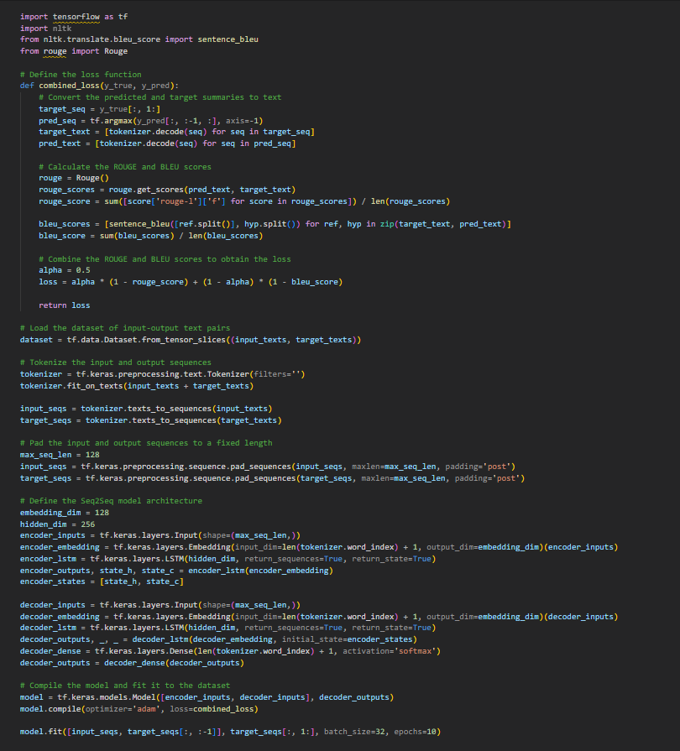

Slide 16
MODEL EVALUATION
Evaluate the performance of the trained model by testing it on a validation set.
Calculate evaluation metrics such as ROUGE score, BLEU score, and F1 score.

Slide 17
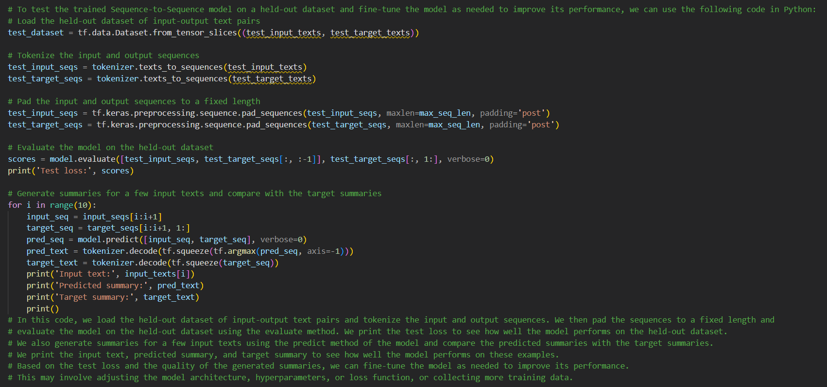

Slide 18
GENERATING SUMMARIES
Use the trained sequence-to-sequence model with word sense disambiguation and semantic content generalization techniques to generate abstractive summaries.

Slide 19
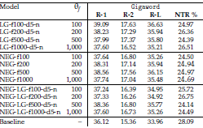
Results
Gigaword Dataset | Rouge Score -1
Kouris, Alexandridis, and Stafylopatis | 39.09

Slide 20
THANK YOU

